Slide 1
Bitcoin
Unit-4

Slide 2

There are a number of currencies in this world used for trading amenities. Rupee, Dollar, Pound Euro, and Yen are some of them. These are printed currencies and coins and you might be having one of these in your wallet. But bitcoin is a currency you can not touch, you can not see but you can efficiently use it to trade amenities. It is an electronically stored currency. It can be stored in your mobiles, computers, or any storage media as a virtual currency.

Slide 3
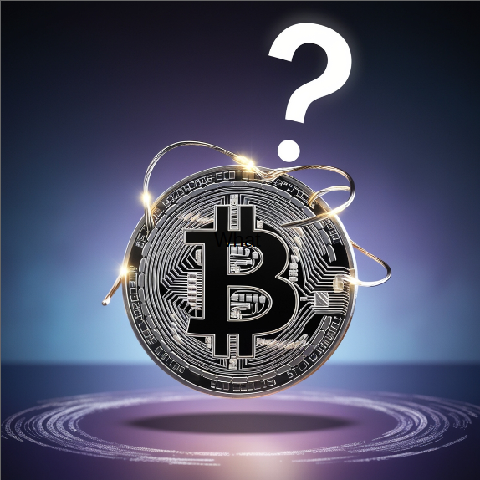
Bitcoin is a type of digital currency, also known as a cryptocurrency. It allows people to send and receive money over the internet without the need for a central authority, like a bank.

Slide 4
There are 3 ways you can get a bitcoin in your electronic storage:
Trade Money For Bitcoin: Say that the value of a bitcoin is 1 lakh rupees, so if you want a bitcoin, you can trade a bitcoin in place of 1 lakh rupees. This Bitcoin will further be stored in your electronic storage media which you can further use.
Trade Goods For Bitcoin: Say that the value of a bitcoin is 1 lakh rupees and you have a commodity that has its value as 1 lakh rupees, so you can trade that commodity in place of a bitcoin, and the bitcoin will be stored in your electronic storage media.
Mine Bitcoins: Other than trading, you can also mine bitcoins. Since it is a decentralized currency, there is no authority that brings bitcoins into the market. Bitcoins only come into the market by mining them.

Slide 5
Features
Distributed: All bitcoin transactions are recorded in a public ledger known as the blockchain. There are nodes in the network that maintain copies of the ledger and contribute to the correct propagation of the transactions following the rules of the protocols making it impossible for the network to suffer downtime.
Decentralized: There is no third party or no CEO who controls the bitcoin network. The network consists of willing participants who agree to the rules of a protocol and changes to the protocol are done by the consensus of its users. This makes bitcoin a quasi-political system.

Slide 6
Transparent: The addition of new transactions to the blockchain ledger and the state of the bitcoin network is arrived upon by consensus in a transparent manner according to the rules of the protocol.
Peer-to-peer: In Bitcoin transactions, the payments go straight from one party to another party so there is no need for any third party to act as an intermediary.
Censorship resistant: As bitcoin transactions are pseudo-anonymous and users possess the keys to their bitcoin holdings, so it is difficult for the authorities to ban users from using their assets. This provides economic freedom to the users.

Slide 7
Public: All bitcoin transactions are available publicly for everyone to see. All the transactions are recorded, which eliminates the possibility of fraudulent transactions.
Pseudo-anonymous: Bitcoin transactions are tied to addresses that take the form of randomly generated alphanumeric strings.

Slide 8
How Do Bitcoin Transactions Work?
Bitcoin transactions are digitally signed for security. Everyone on the network gets to know about a transaction. Anyone can create a bitcoin wallet by downloading the bitcoin program.

Slide 9
Each bitcoin wallet has two things:
Public key: It is like an address or an account number via which any user or account can receive bitcoins.
Private key: It is like a digital signature via which anyone can send bitcoins.
The public key can be shared with anyone but the private key must be held by the owner. If the private key gets hacked or stolen then bitcoin gets lost.

Slide 10
A bitcoin transaction contains three pieces of information:
Private key: The first part contains the bitcoin wallet address of the sender i.e. the private key.
Amount of bitcoin to be transferred: The second part contains the amount that has been sent.
Public key: The third part contains the bitcoin wallet address of the recipient i.e. the public key.

Slide 11
How Do Bitcoins Come Into Market?
Bitcoins are a decentralized currency, they aren’t printed, like rupees, they’re produced by people, and big companies, running computers all around the world, using software that solves mathematical problems.
Bitcoins are mined using the computing power of the distributed network. This network also processes transactions made using Bitcoin.
Bitcoins are mined on the basis of computing power, so they take time to be generated.
To keep it valuable, it has been stated that only 21 million bitcoins can be created by miners. By the year 2140, all the bitcoins will be created.

Slide 12
How Do You Buy Bitcoin?
There are three ways to get a bitcoin:
Buying: Many marketplaces like Bitcoin exchanges allow users to buy or sell bitcoins using different currencies. If one does not want to mine a bitcoin, it can be bought using a cryptocurrency exchange. Most people will not be able to purchase the entire BTC due to its price, so it is possible to buy portions of BTC on these exchanges in fiat currency like U.S. Dollars.
The following steps can be followed to buy bitcoin outside the online exchanges:
Each person who joins the bitcoin network is issued a public key and a private key.
When a person buys a bitcoin or sends/receives it, the person will receive a public key.
The person can only access the bitcoin using the private key (it has) with the public key (it received).

Slide 13
Mining: People on the bitcoin network compete among themselves to mine bitcoins using computers to solve complex maths puzzles. This is how bitcoins are created.
Transfer: Bitcoin can be transferred from one account to another just like digital cash using mobile applications or computers.

Slide 14
Bitcoin Key Concepts
There are four key concepts in Bitcoin that are as follows-
Disintermediated
When users send money over the Internet, there is a need for a third party, such as a bank, to manage all the transactions. However, in Bitcoin, transactions are made directly over the Internet to another party. This transaction is carried out on the Bitcoin network. This network is in charge of confirming and verifying that the two parties actually exchanged value. This is known as disintermediation. The act of removing the middleman is known as disintermediation. It is one of the key components that make the blockchain so valuable because it eliminates the unnecessary inefficiency that occurs when a third party is used to transfer value between parties.

Slide 15
Distributed: The entire bitcoin network is powered by a network of thousands of distributed computers that share the workload. As a result, rather than having a single centralized computer handle the workload, the workload is distributed across multiple computers. Because there is no single point of failure, the distributed network is more reliable. The workload is distributed across thousands of computers that are all running and sharing the workload.

Slide 16
Decentralized: Bitcoin is a decentralized currency. It means that there is no central command, no central data repository, and no middle management to oversee what Bitcoin does. As a result, there isn’t a solitary point of failure.
Trustless: Bitcoin is called Trustless because no third party, such as a bank, is required to certify and trust the entire transaction process. Instead, the blockchain and the way Bitcoin processes transactions enable trust via Distributed Trustless Consensus, in which all nodes agree that a transaction took place.

Slide 17
Merits of Bitcoin
User anonymity: Bitcoin users can have multiple public keys and are identified by numerical codes. This ensures that the transactions cannot be traced back to the user.
Transparency: Bitcoin transactions are recorded on the public ledger blockchain. The transactions are permanently viewable, which gives transparency to the system but they are secure and fraud-resistant at the same time due to blockchain technology.

Slide 18
Accessibility: Bitcoin is a very versatile and accessible currency. It takes a few minutes to transfer bitcoins to another user, so it can be used to buy goods and services from a variety of places accepting bitcoins. This makes spending bitcoin easy in another country with little or no fees applied.
Independence from central authority: Bitcoin is a decentralized currency, which means there is no dependence on any single governing authority for verifying transactions.
Low transaction fees: Standard wire transfers involve transaction fees and exchange costs. Since bitcoin transactions do not involve any government authority so the transaction fees are very low compared to bank transfers.

Slide 19
Demerits of Bitcoin
Volatility: There are various factors that contribute to the bitcoin’s volatility like uncertainty about its future value, security breaches, headline-making news, and one of the most important reasons is the scarcity of bitcoins. It is known that there is a limit of 21 million bitcoins that could ever exist which is why some regard bitcoin as a scarce resource. This scarcity makes bitcoin’s price variable.
No government regulations: Unlike the investments that are done through central banks, bitcoins transactions are not regulated by any central authority due to a decentralized framework. This means that bitcoin’s transactions don’t come with legal protection and are irreversible which makes them susceptible to crimes.

Slide 20
No buyer protection: If the goods are bought using bitcoins and the seller does not send the promised goods then nothing can be done to reverse the transactions and since there is no central authority so no legal protection can be provided in this case.
Not widely accepted: Bitcoins are still only accepted by a small group of online merchants. This makes it unfeasible to rely completely on bitcoin as a currency and replace it with traditional bank transactions.
Irreversible: There is a lack of security in bitcoin transactions due to the anonymous and non-regulated nature of the bitcoin transactions. If the wrong amount is sent or the amount is sent to the wrong recipient then nothing can be done to reverse the transactions

Slide 21
Forks and SegWits
A fork in blockchain refers to a split in the blockchain network, creating two separate chains.
Forks are classified as:
Hard fork
Soft fork

Slide 22
Hard forks require all participants to upgrade and can cause a permanent split.
A soft fork is a backward-compatible upgrade, meaning that non-upgraded nodes will still recognize new blocks as valid.

Slide 23
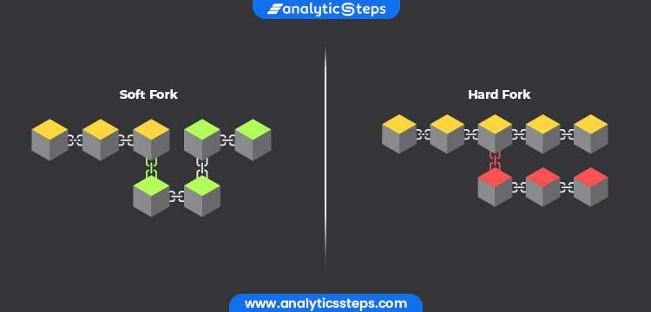

Slide 24
Hard Fork
The users who are running the older version of the software in the Bitcoin network needs to upgrade their software to recognize new blocks.
Soft Fork
The users who are running the older version of the software will still recognize new blocks created by computers. It is called soft because both groups of users(old and new users) will continue to mine new blocks on the same blockchain.

Slide 25
Hard Fork
Example: Bitcoin Cash (BCH) from Bitcoin (BTC)
In 2017, some people in the Bitcoin community wanted to increase the block size limit to allow more transactions per block, making the network faster. They couldn't reach an agreement with everyone else, so they created a new version of Bitcoin called Bitcoin Cash with larger block sizes. This split, or "hard fork," created two separate cryptocurrencies: Bitcoin and Bitcoin Cash. If you held Bitcoin before the fork, you ended up with the same amount of Bitcoin Cash after the fork.

Slide 26
Soft Fork
Example: Segregated Witness (SegWit) in Bitcoin
SegWit was introduced to Bitcoin in 2017 as an upgrade to improve transaction efficiency and fix issues. Unlike a hard fork, a soft fork doesn’t require everyone to upgrade right away. Those who upgrade follow the new rules but those who don’t upgrade can still participate in the network.

Slide 27
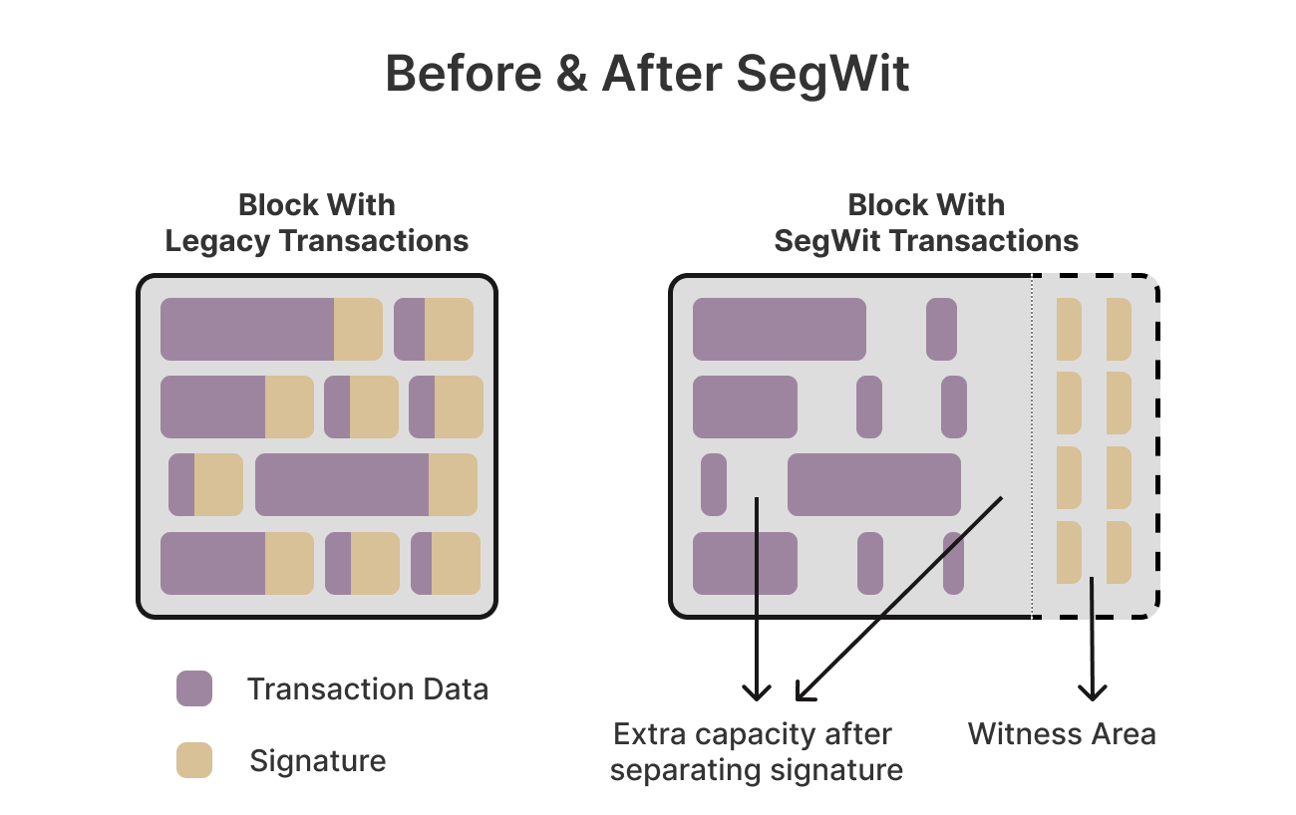
In SegWit (Segregated Witness), the digital signature is moved from the main part of the Bitcoin transaction (known as the transaction data) into a separate structure called the witness

Slide 28
The soft fork that was represented for segregated witness does not require upgrading to remain on the blockchain. It means that if miners have not upgraded the segregated witness can still remain on the blockchain. They won't have access all the functionality that segregated witness can provide and also being able to participate in segregated witness transaction. However, they would still be able to validate the block that does not include the segregated witness information in them.

Slide 29
Hard Fork | Soft Fork
A major update that is not backward-compatible, resulting in a permanent split. | A minor update that is backward-compatible, allowing everyone to remain on the same blockchain.
Old rules are not compatible with the new rules. | Old rules are compatible with the new rules.
Results in two separate blockchains (e.g., Bitcoin and Bitcoin Cash). | Does not split the blockchain; remains as one.
Requires all participants to upgrade to the new version to continue on the new chain. | Only a majority needs to adopt the new rules; non-upgraders can still participate.
Ethereum and Ethereum Classic, Bitcoin and Bitcoin Cash. | Bitcoin's SegWit update.

Slide 30
There are three main components of the bitcoin transaction. They are
Input: Where the coin/funds are coming from.
Amount: How many bitcoins are coming from the source.
Output: Where that bitcoin are actually headed.
A transaction is very similar to a bank check, which contains inputs, amount, and output. For the transaction to happen, someone who has bitcoin needs to sign that transaction. The signature makes sure that your bitcoin cannot be used by someone who is not authorized. It is because you have the private keys that can be controlled by you only.

Slide 31
Now in SegWit transaction, the digital signature needs to be segregated from the transaction data. It would increase the 1 MB limit for block sizes. The digital signature freezes up about 60-65% of the space in a given transaction. SegWit transaction ignores the data attached to a signature by pulled out the signature from within the input and moving it to a structure towards the end of a transaction.

Slide 32
Sending and Receiving Bitcoin
Sending and receiving bitcoin is one of the core building blocks of any bitcoin application. Sending and receiving bitcoins securely over the internet gives you a bitcoin value. To send and receive bitcoin, you need to have a wallet where you need to put the public address of the sender and recipient. The process of sending and receiving bitcoin can differ between wallets to wallets, but the general steps are given below.
Step-1 Log-in into your wallet.
Step-2 Go to Send and Receive icon.
Step-3 Choose whether you want to send or receive bitcoin.

Slide 33
Step-4 Send bitcoin: Enter the public address of the recipient and choose the amount which you want to send. Once you decide the amount, confirm the amount to avoid mistakes, then click on send transaction, and verify the transaction one last time for confirming your public address and sender's public address.
Step-5 Receive bitcoin: To receive bitcoin, you need to share your public wallet address with the sender. You can also do this by letting them scan a QR code.

Slide 34
For example:
A wants to send five bitcoins to Ben. She is sending five bitcoins because she may have bought a product or paying him for services. For sending those five bitcoins, A needs to have five bitcoins in her wallet, and can also be able to receive bitcoins in her wallet. Now she could have bought bitcoins, or she could have received bitcoins as payment.
Here, we are assuming that A has 20 bitcoins in her wallet. When the wallet is created, it assigns two keys. One is the public key which is used to receive bitcoins. And second is the private key which is used to sign and authorize to send or spend those bitcoins to other people. We know that A has the private key to her wallet, so she is able to spend those bitcoins.
Ben can receive five bitcoins if he has a wallet of his own, which allows him to get bitcoins from anyone else. Ben also has a private key for his wallet that will enable him to spend those bitcoins that he has in his wallet. Ben's private key is completely different from Alice's private key. Now, if Ben wants to receive five bitcoins from A, he needs to provide his Bitcoin address to A.

Slide 35
The bitcoin address is used for receiving money, which is a hashed version of the public key. Ben has the option to generate a new bitcoin address for every single transaction if he wants. Creating the new bitcoin address for every transaction is a good security recommendation in terms of privacy.
Ben can share his bitcoin address in two ways. He can share an alphanumeric code which starts with the number one and ends in the letter H, and another one is the QR code. The alphanumeric code is always different for every single bitcoin address, and these addresses are typically between 26 to 35 characters in length. The bitcoin address which you see numerically is the Ben address used to receive bitcoins from A.
Now, when A sends the five bitcoins to that address, she creates a transaction. She is able to do this transaction because she can access the private key and can authorize to transfer five bitcoins on Ben's bitcoin address. So, a new transaction shows that from A's wallet, five bitcoins are being sent to Ben's wallet. The transaction at that point gets sent out into the network, and the miners begin mining blocks. When the first block comes in and includes that transaction in it, then the transaction is said to be confirmed.

Slide 36
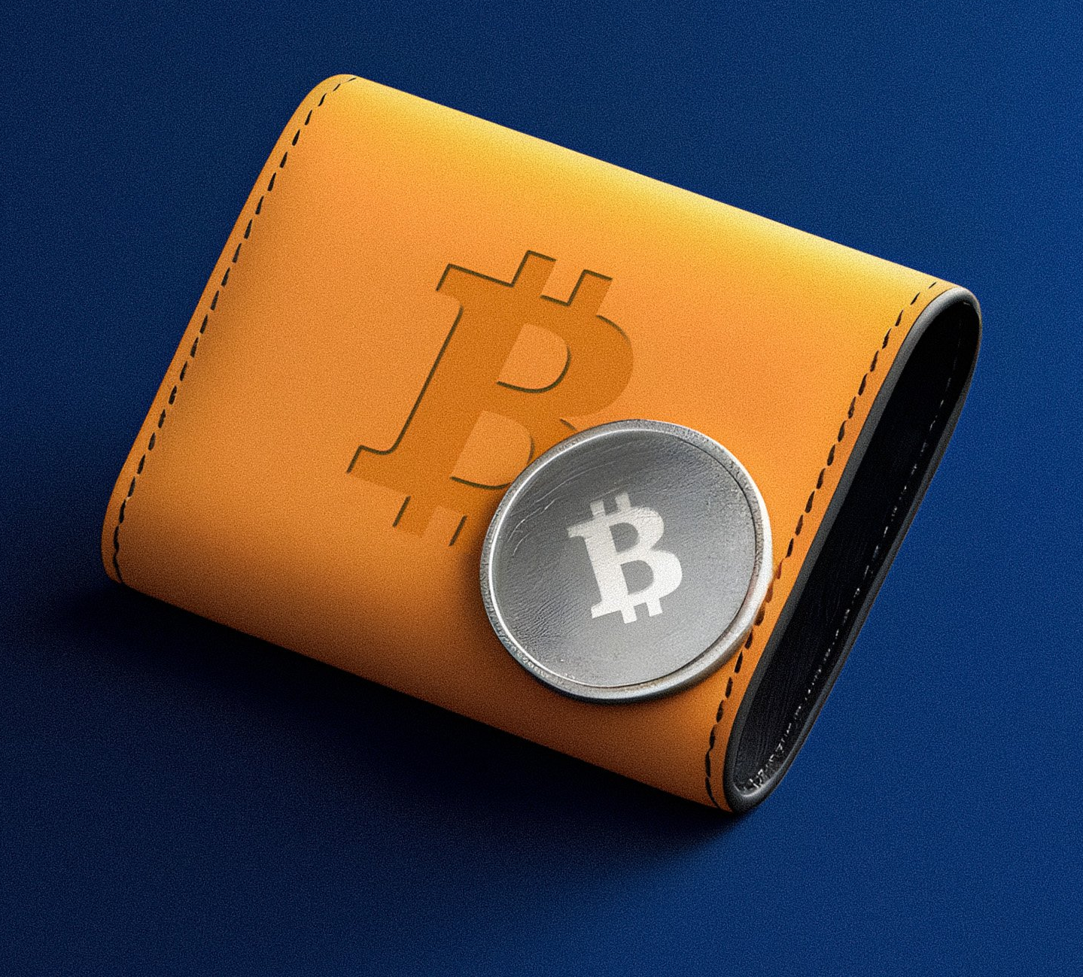
How to Choose Bitcoin Wallet
If you want to involve in bitcoin, you need to have a wallet.
A wallet allows you to receive bitcoins, send bitcoins, store bitcoins.

Slide 37
Take an example of a page called bitcoin.org to choose the wallet
Bitcoin.org is a website that was developed by Satoshi Nakamoto and Martti Malmi.
It's an open-source project which is handled by a global community.
Bitcoin.org is a very good starting point to explain how to choose your wallet because there is a lot of options available. In this page, we will go to an option called Choose your wallet.

Slide 38
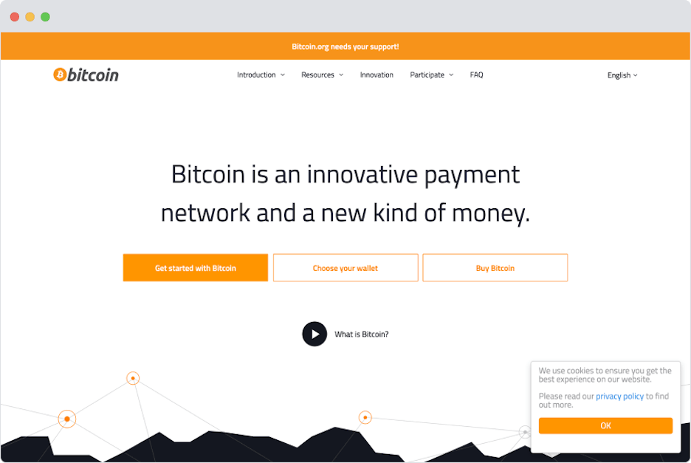

Slide 39
We can see that there are different types of wallets that you can choose, like Desktop wallet, Mobile wallet, Web wallet, Hardware wallet, etc.

Slide 40
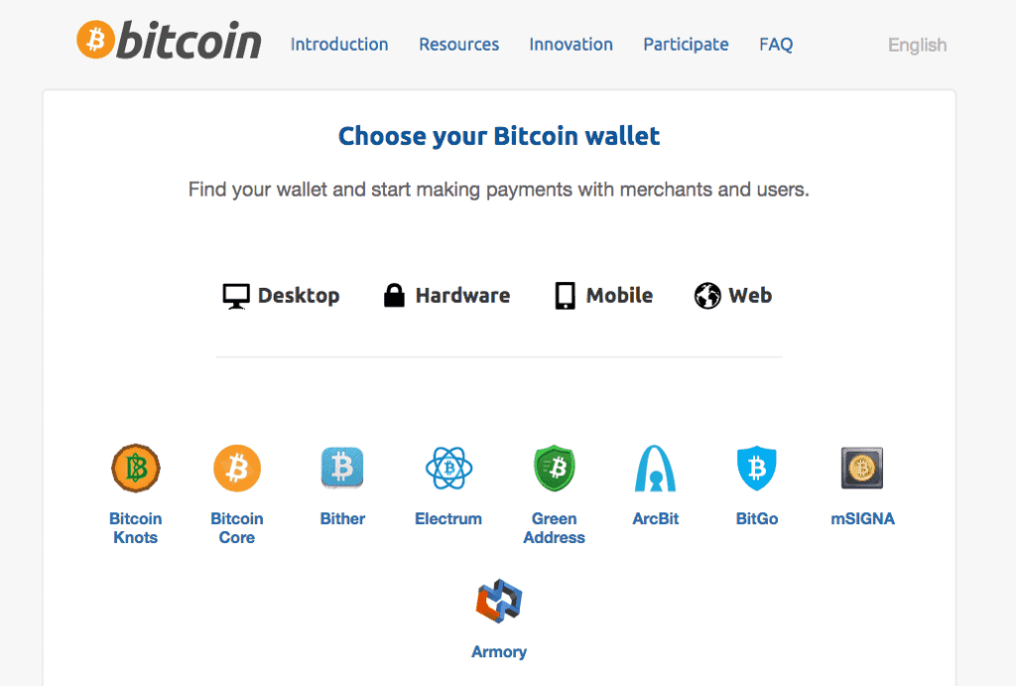

Slide 41
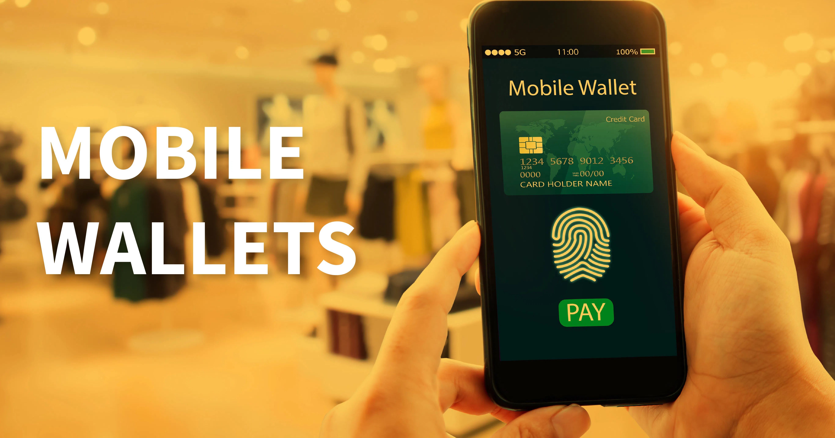
Mobile wallet
In the mobile wallet, you can run any type of application, whether it is on Android, iOS, Windows
Popular Mobile wallets are Bitpay, BTC.com, Edge, Electrum, Mycelium, Bitcoin Wallet, etc.

Slide 42
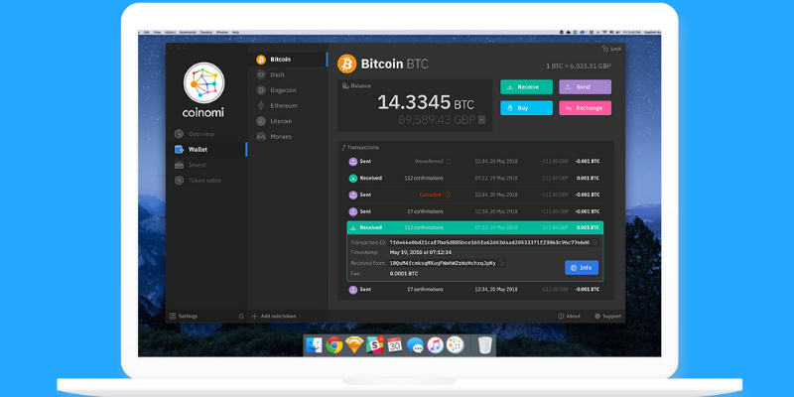
Desktop wallet
In the desktop wallet, you can run it on your desktop or laptop computer for Windows, Mac, and Linux. Generally, they are secure, but sometimes they are vulnerable to various malware and computer viruses.
Popular Desktop wallets are Bitcoin Core, Bitcoin Knots, mSIGNA, Armory, etc.

Slide 43
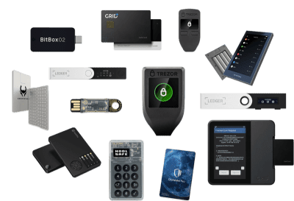
Hardware wallet
In a hardware wallet, there are devices which contain your private keys. The hardware wallets are the most secure wallets, but it will also cost money.
Popular hardware wallets are BitBox, Keepkey, Trezor, Ledger Nano S, etc.

Slide 44
Web wallet
The web wallets are online wallets that are considered less secure than other types of wallets, yet they can be highly convenient.
Popular web wallets are Guarda, Coinbase, GreenAddress, Binance, etc.

Slide 45
Different Ways to Convert Bitcoin to Fiat Currency
Bitcoin is basically a cryptocurrency that is stored in a virtual wallet. It is basically a digital currency that is currently used as a form of payment. The transactions related to bitcoins take place in the blockchain network. Every bitcoin is stored in a virtual wallet and the transaction involves the transfer of bitcoin from one wallet to another. Bitcoins can be sent from peer to peer irrespective of geographical location without any intermediator in between. It works in a decentralized way, meaning nobody can interfere with the digital money, only the concerned person is responsible for the bitcoins.
Fiat currency is the currency that is issued by the government. in other terms. It is the cash, coins we generally have, that is the physical form of currency. Fiat currency ranges from USD, EUR, INR, GBP, etc.

Slide 46
There are many ways to convert bitcoin to fiat currency. The methods are listed below
Cryptocurrency Exchanges: This is the most widely used method to convert bitcoin to fiat currency. It is similar to a money exchange center which is needed when a person moves from one country to another. Cryptocurrency exchanges basically convert your cryptocurrency that is bitcoin into your local currency such as rupees, US dollars, euros.

Slide 47
Cryptocurrency Exchanges have an inbuilt crypto converter feature that displays how much fiat currency one could get with the bitcoins that person has. There are multiple exchanges available like Gemini, coinbase, binance, etc. This has a user-friendly interface that eases the whole process of bitcoin conversion
Coinbase seems a suitable option as it has improved over its downtime problem by increasing the infrastructure capability. Coinbase exchange sends the converted fiat money directly into your bank account without much hassle.

Slide 48
Bitcoin Debit Card: Possessing a Bitcoin Debit Card is the fastest way to convert bitcoin to cash or fiat currency. The online website is provided as a user interface where the user deposits the bitcoins and the website automatically converts those into required fiat currency. Bitcoin debit cards are used wherever debit cards are accepted, the only difference being, funds are transferred from a crypto wallet rather than from a bank account
The main disadvantage is the providers of Bitcoin debit cards takes transaction charge on every purchase and also limits the total amount of transaction per debit card.In order to register for the Bitcoin debit cards, one needs to go to the bank and do KYC.

Slide 49
Peer-to-Peer Exchanges: It is known that bitcoin doesn’t have any centralized authority, therefore any fund can be transferred from one peer to another. This basically involves finding a buyer who will buy your bitcoins and in return, would give cash for that. But one thing to be noted is that transactions in bitcoins are irreversible. So, choose a trustworthy buyer on whom you are sure of getting the cash after a bitcoin transaction.
Bitcoin ATMs: It is also known as a Bitcoin Teller Machine (similar to ATM). BTM acts similar to an ATM, allowing to withdraw cash. QR code and added security features like text messages are there to ensure smooth and secure transactions. BTMs allow you to buy as well as sell bitcoins.it provides a very fast and convenient way to take cash out of a bitcoin wallet. BTMs are available in developed cities of the world and more are under construction after the boom of the digital currency era. The drawback of BTMs is they charge a heavy amount on conversion and also sets a maximum transaction limit.

Slide 50
Metal Pay: It is a money transfer app that allows cryptocurrency holders to cash out. The need for this app is to complete KYC before filling up the bank details. After filling in bank details, the customer can buy, sell, send, receive as well as convert cryptocurrencies. Metal pay has the capability to convert at least 24 cryptocurrencies including bitcoins.

